Slide 1
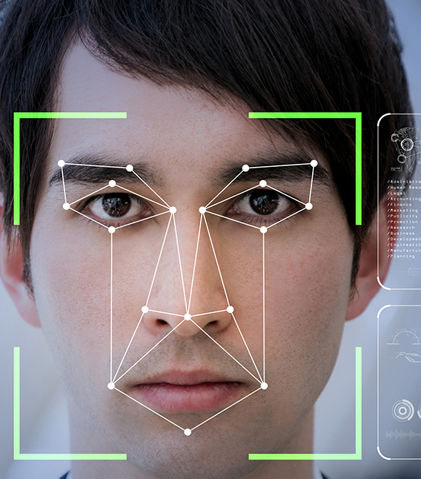
GESTURE BASED MOUSE CONTROL
A new expressive way of using mouse.

Slide 2
BATCH - 02
ID NUMBER | NAME
20171CSE0512 | POORNIMA K N
20171CSE0680 | SRINAG MARNI
20171CSE0686 | SUJAYA V SHETTY
20171CSE0694 | SUSHMA S K
Batch-02
GUIDED BY:
MRS. SWETHA P C

Slide 3
SYSTEM STUDY
A computer mouse is a hand-held pointing device that detects two-dimensional motion relative to a surface. This motion is typically translated into the motion of a pointer on a display, which allows a smooth control of the graphical user interface of a computer.
A gesture recognition models is designed which recognize facial gestures based on the input signal from webcam. It takes advantage of continuity and dynamics of the user's movement of the facial gestures to control the mouse movement.
This is implemented using image processing technologies.
The image based eye tracking uses a camera to record images.
Several approaches can be combined to acquire the eyes position in the recorded image.
Batch-02

Slide 4
SYSTEM ANALYSIS
COMPONENTS REQUIRED :
Microphone
Webcam
LIBRARIES USED :
NumPy — 1.13.3
OpenCV — 3.2.0
PyAutoGUI — 0.9.36
Dlib — 19.4.0
speech recognition 3.7.1
ENVIRONMENT REQUIRED :
Python 3.6
Batch-02
RESOURCES REQUIRED :
Dedicated 256 MB RAM
180 MB ROM
Internet Connection
4

Slide 5
LITERATURE SURVEY
Ref. No | Paper Title | Authers Names | Journal Name, Publisher and year | Technique used | Research Gap
1 | Gesture Based Mouse Control | Mrs.M.S.Ghute, Ms.Mohsina Anjum, Mrs K.P.Kamble | 2nd International conference on Electronics, Communication and Aerospace Technology (ICECA 2018) | Gesture, Motion Control, Receiver, Transmitter, XBee | This paper enforces the user to put tape around fingers and requires additional hardware.
2 | Augmented EMTCNN: A Fast and Accurate Facial Landmark Detection Network | Hyeon-Woo Kim, Hyung-Joon Kim, Seungmin Rho and Eenjun Hwang | 2019 IEEE International Conference on Big Data and Smart Computing (BigComp), Kyoto, Japan, 27 February–2 March 2019. | facial landmark extraction, convolutional neural networks, cascaded structure, face detection | This paper could not coordinate with the system and output.
3 | Facial Expression Based Computer Cursor Control System for Assisting Physically Disabled Person | M. Vasanthan, M. Murugappan, R. Nagarajan, Mr. Bukhari Ilias, J. Letchumikanth | COMNETSAT 2012,IEEE | Facial features, facial expressions, cursor control, BASIC STAMP microcontroller | wearing of four markers permanently on the user face is highly intrusive for the subjects
Batch-02

Slide 6
GOAL OF THE SYSTEM
1. Hands-free mouse controlling
2. To establish vision based system
3. Controlling mouse motions using facial gesture and voice
4. To eliminating the limitations of stationary head
5. To be available in all platforms independent of the OS
Batch-02

Slide 7








BLOCK DIAGRAM
Sensors
Face detection
Squint detection
Gaze Determination
Blink Detection
Mouse Scrolling
Cursor Movement
Clicking Event
Image Processing and capturing
Speech Recognition System
Word Matching
Type by voice
Screenshot
Batch-02
7

Slide 8
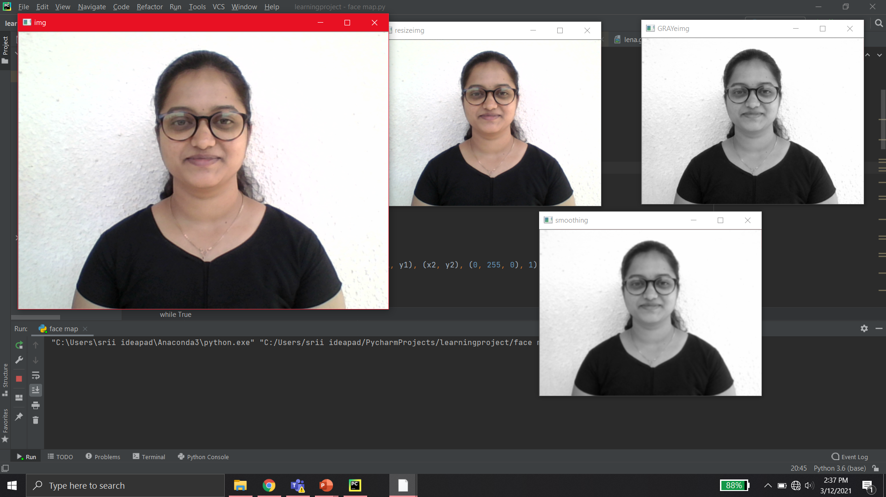
IMAGE CAPTURING AND PROCESSING
Batch-02

Slide 9
What are shape/landmark predictors?
faces come in all different shapes and sizes, and they all share common structural characteristics — the eyes are above the nose, the nose is above the mouth, etc.
The goal of shape/landmark predictors is to exploit this structural knowledge and given enough training data, learn how to automatically predict the location of these structures.
Batch-02

Slide 10
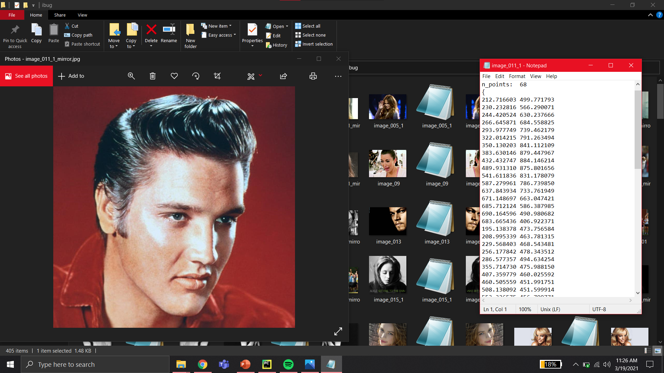
Batch-02

Slide 11
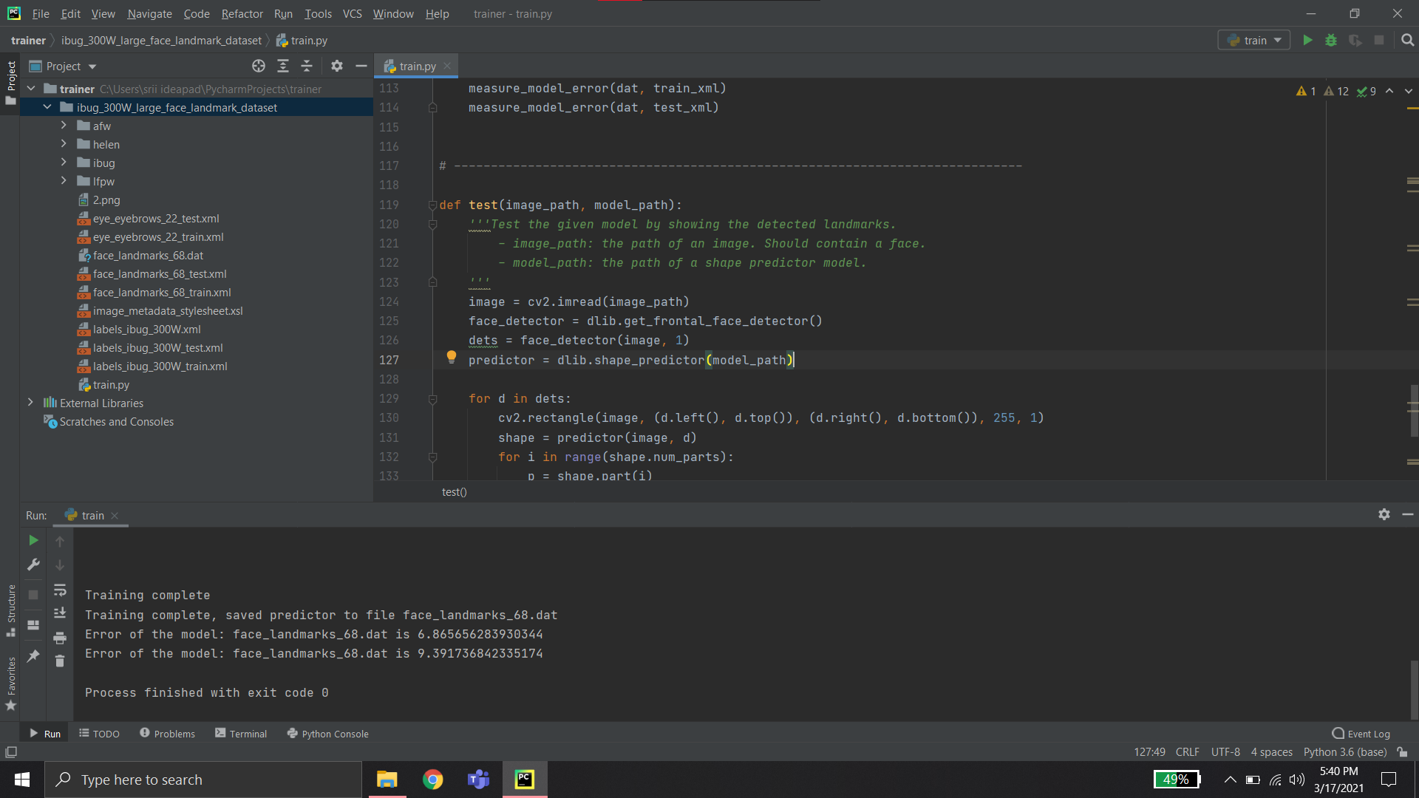
Batch-02

Slide 12
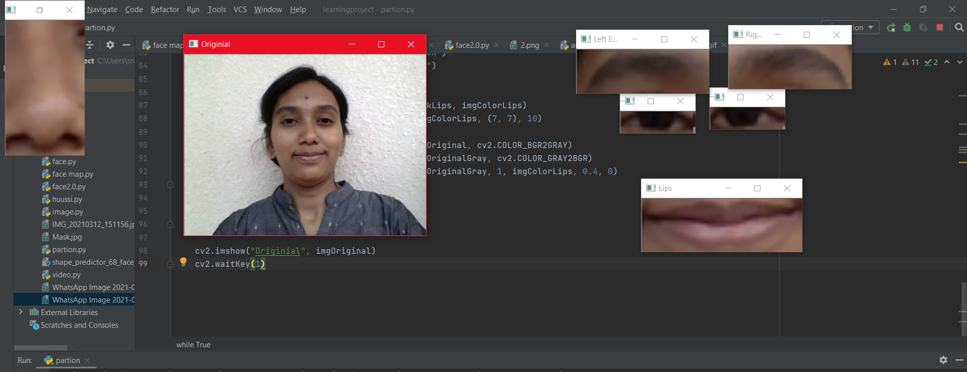
Detecting Facial Landmarks using dlib
Batch-02

Slide 13
EYE MOUSE CONTROLS
RIGHT EYE | LEFT EYE | ACTIONS
CLOSED | OPEN | RIGHT CLICK
OPEN | CLOSED | LEFT CLICK
OPEN | OPEN | MOVING MODE
CLOSE | CLOSE | OFF MODE
Batch-02

Slide 14
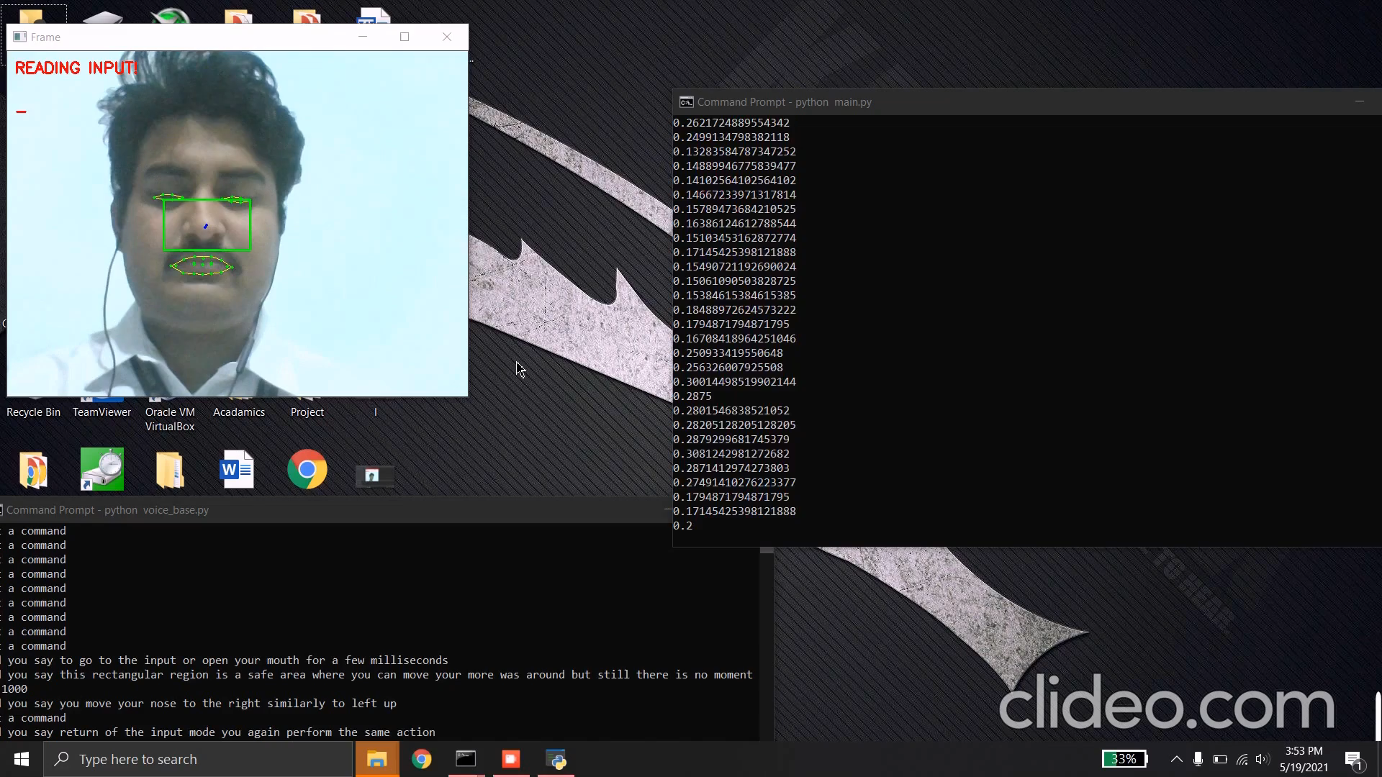
Batch-02

Slide 15
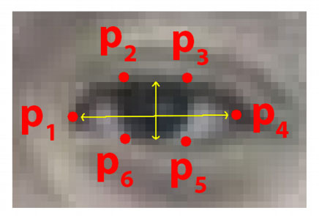
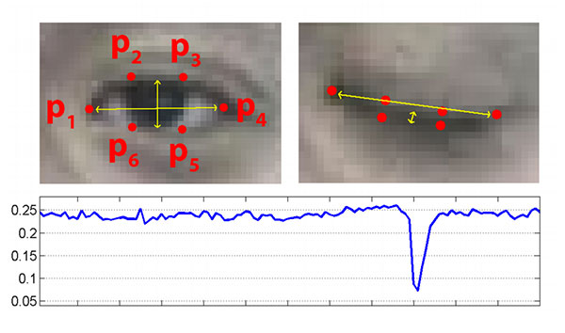
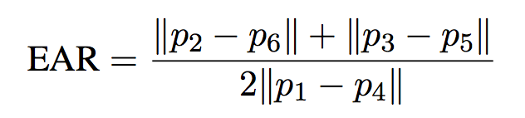
EYE ASPECT RATIO
Each eye is represented by 6 (x, y)-coordinates, starting at the left-corner of the eye (as if you were looking at the person), and then working clockwise around the remainder of the region:
Batch-02

Slide 16
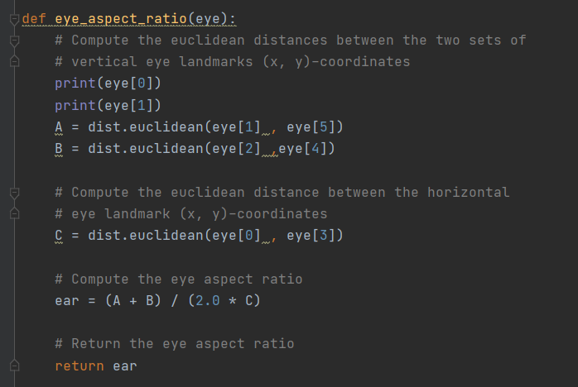
Batch-02

Slide 17
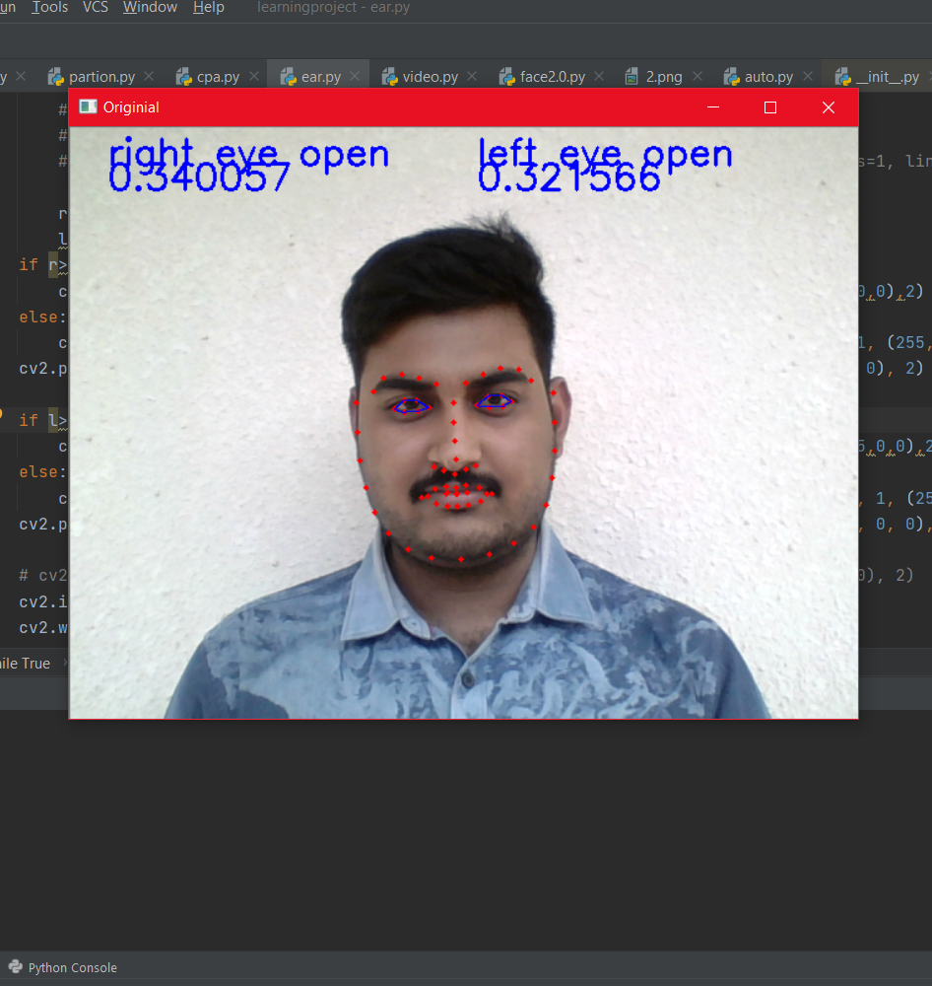
Eye blink detection with OpenCV, dlib
Batch-02
Eye localization.
Thresholding to find if eye is open.
Determining if EAR is below threshold for a period of time (indicating a blink).

Slide 18
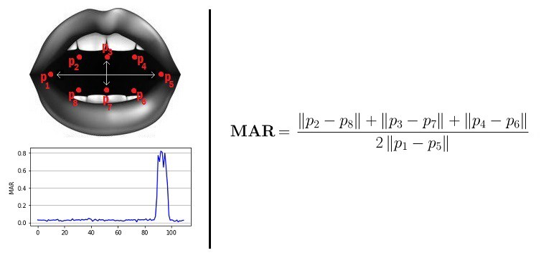
MOUTH ASPECT RATIO
Similar to EAR, MAR value goes up when the mouth opens. Similar intuitions hold true for this metric as well.
Batch-02
18

Slide 19
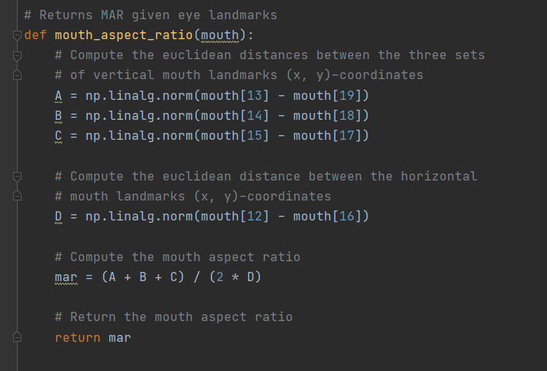
Batch-02
19

Slide 20
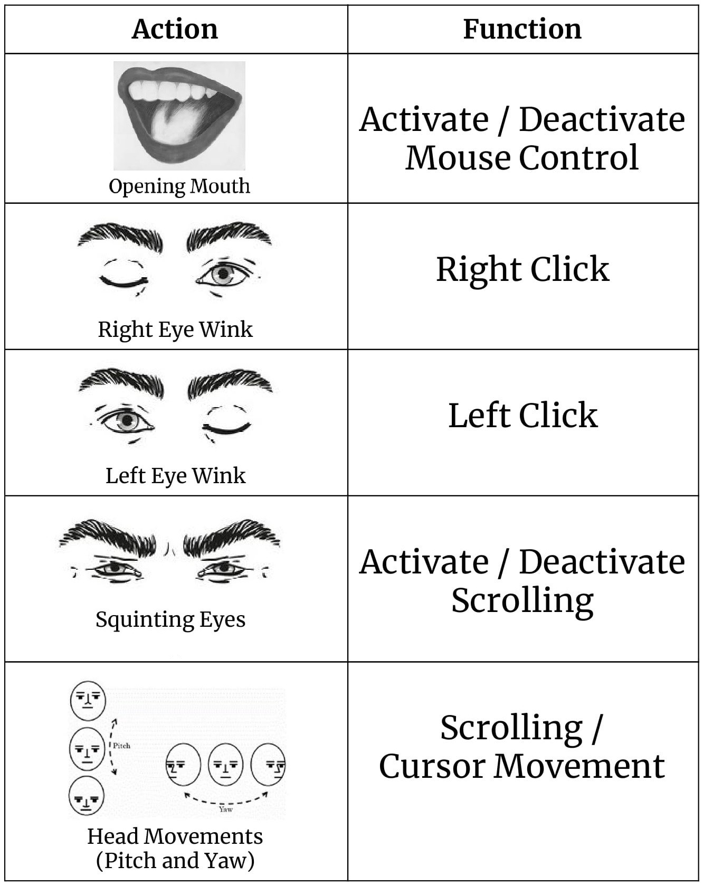
Usage
Batch-02

Slide 21
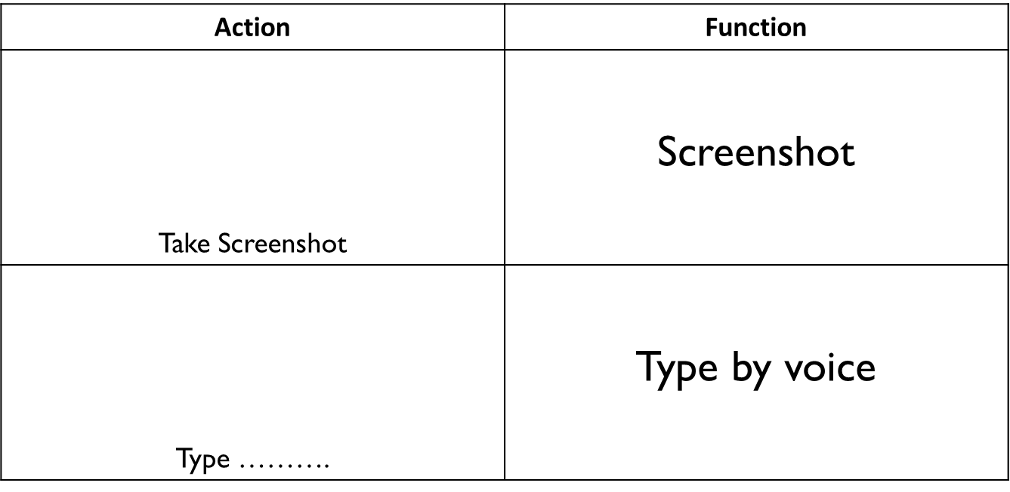
Batch-02

Slide 22
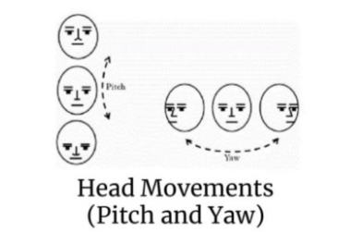
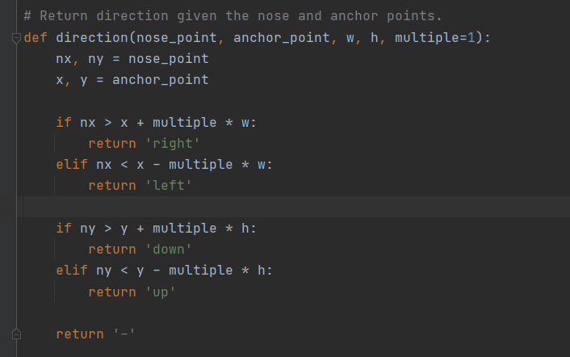
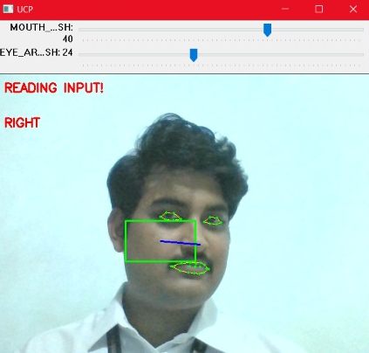
Cursor movement
Batch-02
22

Slide 23
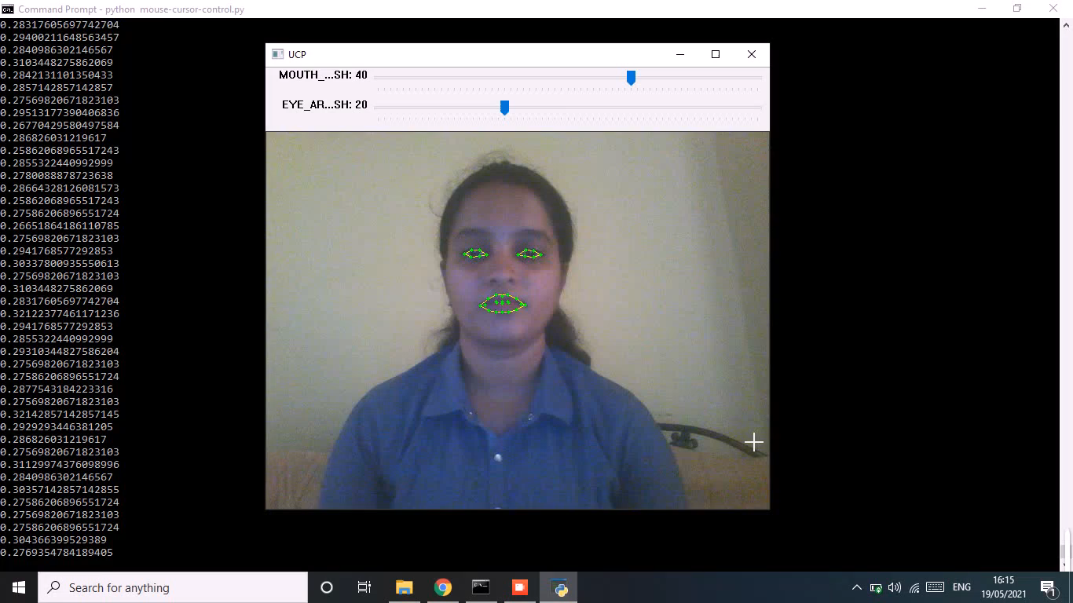
Batch-02
23

Slide 24
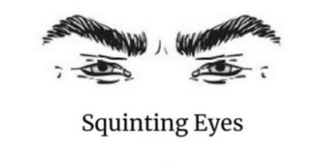
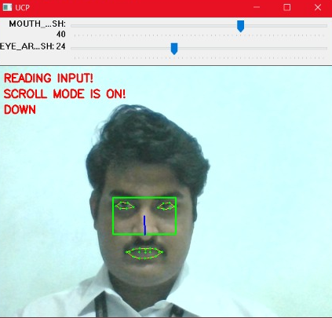
Scroll movement
Batch-02
24

Slide 25
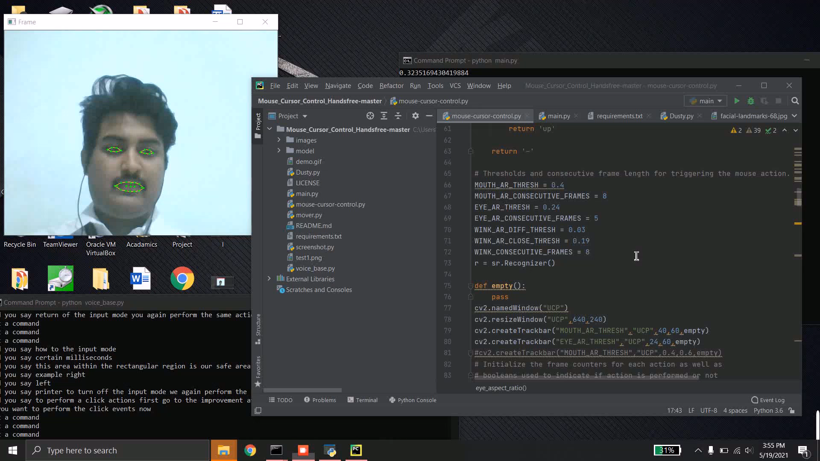
Batch-02
25

Slide 26
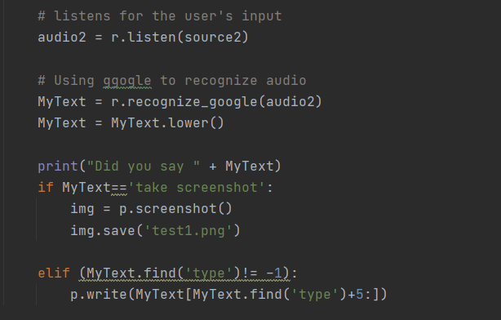
Voice Commands
Why?
Library
Features
Batch-02
26

Slide 27
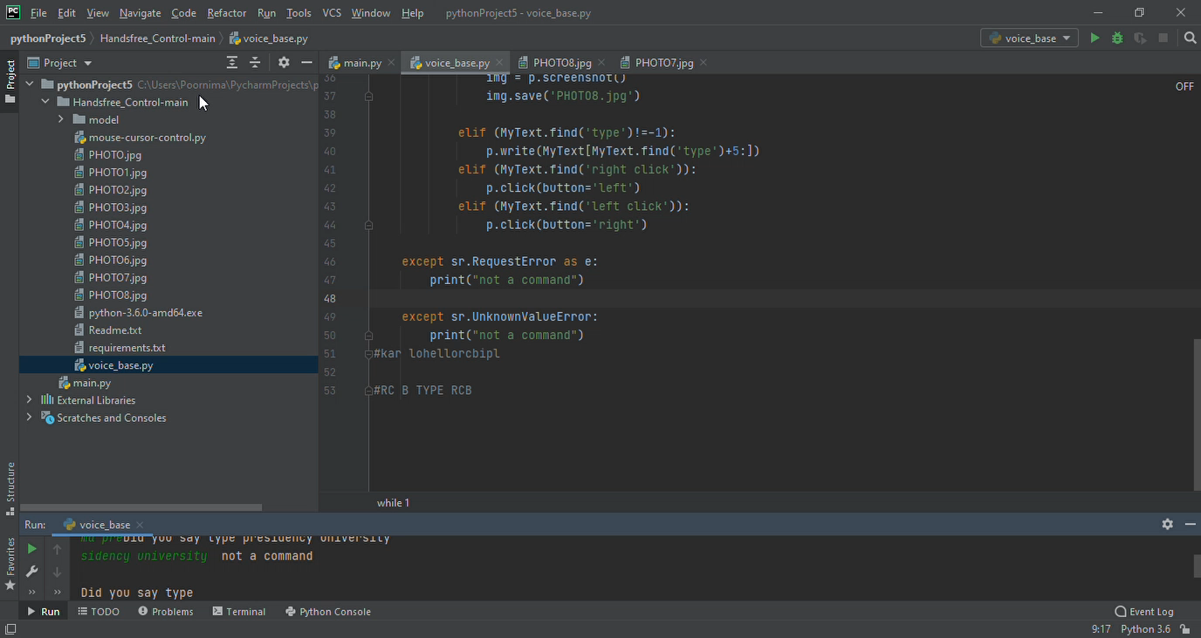
Batch-02
27

Slide 28
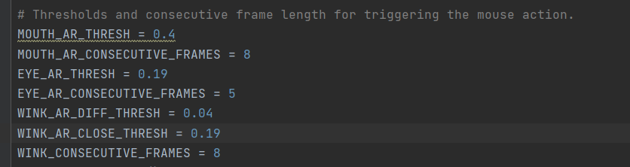
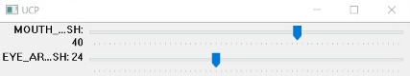
Thresholds & Delays
Batch-02
Why Frames for delay
Fine tunned
Control Panel(not Implemented yet)
28

Slide 29
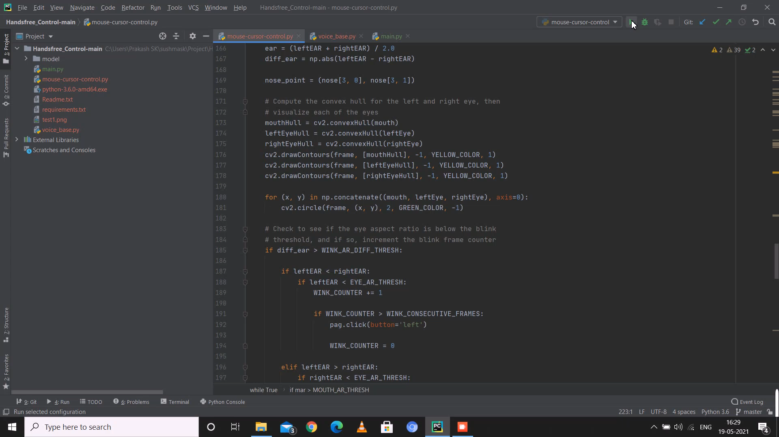
Demonstration
Batch-02

Slide 30
References
“Gesture Based Mouse Control” 2018 Second International Conference on Electronics, Communication and Aerospace Technology (ICECA)
“Facial expression based computer cursor control system for assisting physically disabled person” 2012 IEEE International Conference on Communication, Networks and Satellite (ComNetSat)
“Augmented EMTCNN: A Fast and Accurate Facial Landmark Detection Network” 2019 IEEE International Conference on Big Data and Smart Computing (BigComp), Kyoto, Japan
Hand gesture recognition using a real-time tracking method and hidden Markov model sq Feng-Sheng Chen, Chih-Ming Fu, National Tsing Hua University, ROC Received 15 January 2001
Tereza Soukupova´ and Jan Cˇ ech. Real-Time Eye Blink Detection using Facial Landmarks. In 21st Computer Vision Winter Workshop, February 2016.
Vahid Kazemi, Josephine Sullivan. One millisecond face alignment with an ensemble of regression trees. In CVPR, 2014.
Adrian Rosebrock. Detect eyes, nose, lips, and jaw with dlib, OpenCV, and Python.
Batch-02

Slide 31
Thank You

